Slide 1

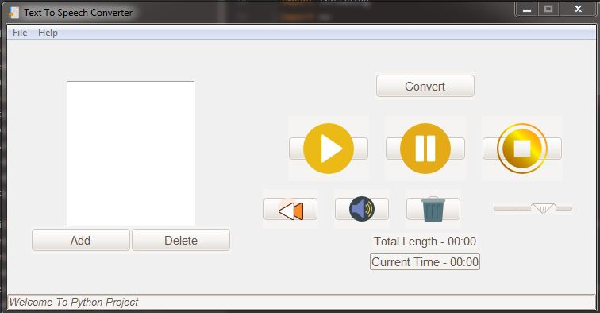
TEXT TO SPEECH CONVERSION
Aadarsh Jadhav
Siddhant Khopade
Vaibhav Shinde
Rohit Kulkarni
Shreeyash Karande

Slide 2
How does it work??
Add the text file that you want to convert
Click on Convert button to convert the text in to audio
Select the Play button in the player to hear the audio
Delete the file by clicking on delete button if required

Slide 3
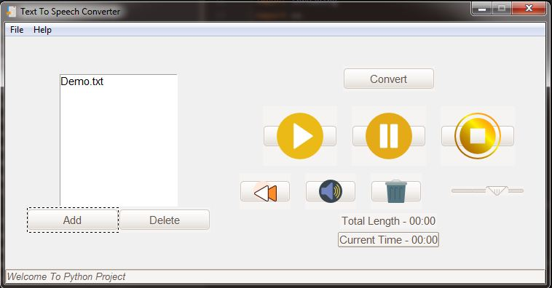
1.Add the text file that you want to convert

Slide 4
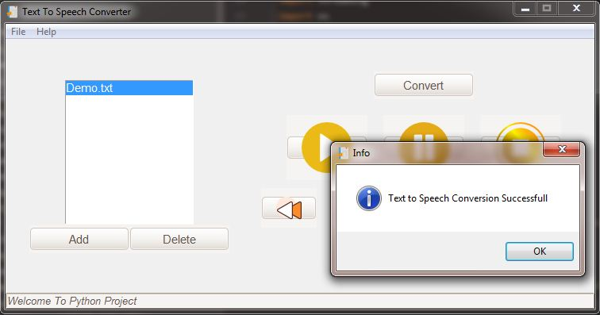
2.Click on Convert button to convert the text in to audio

Slide 5
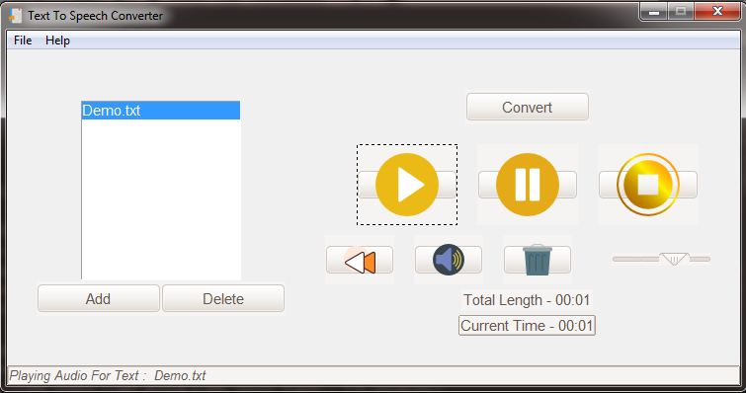
3.Select the Play button in the player to hear the audio

Slide 6
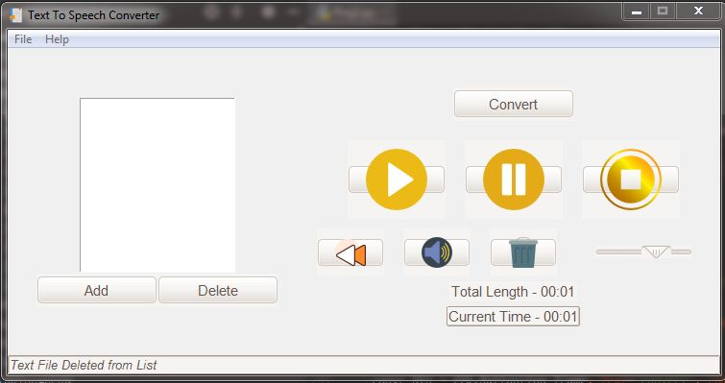
4.Delete the file by clicking on delete button if required

Slide 7
But, How does it really work though?
Functions such as :tkinter,pygame and gTTs are used.
Tkinter: This function is used to pass messages using window box
Pygame:To provide facilities like rewind,set_volume ets in the audio player
gTTS: Actual conversion of text to speech conversion takes place by this function

Slide 8

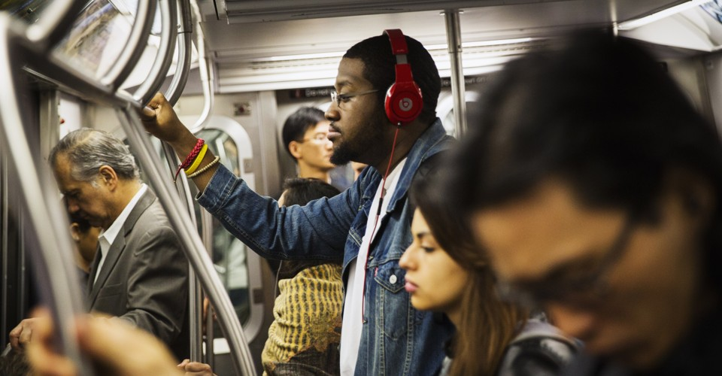

Why do you need it?
For people having literacy difficulties, learning disabilities and reduced vision.
Can be used while doing your chores
For improving listening skills.
Good option for those who like to study while traveling and no more headaches caused by the shaky environment in the bus.

Slide 9
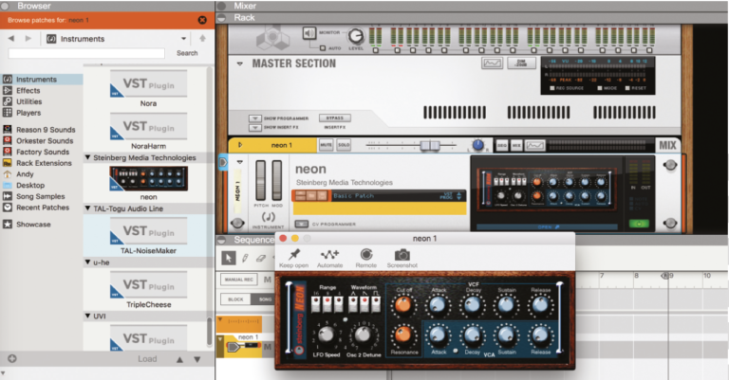
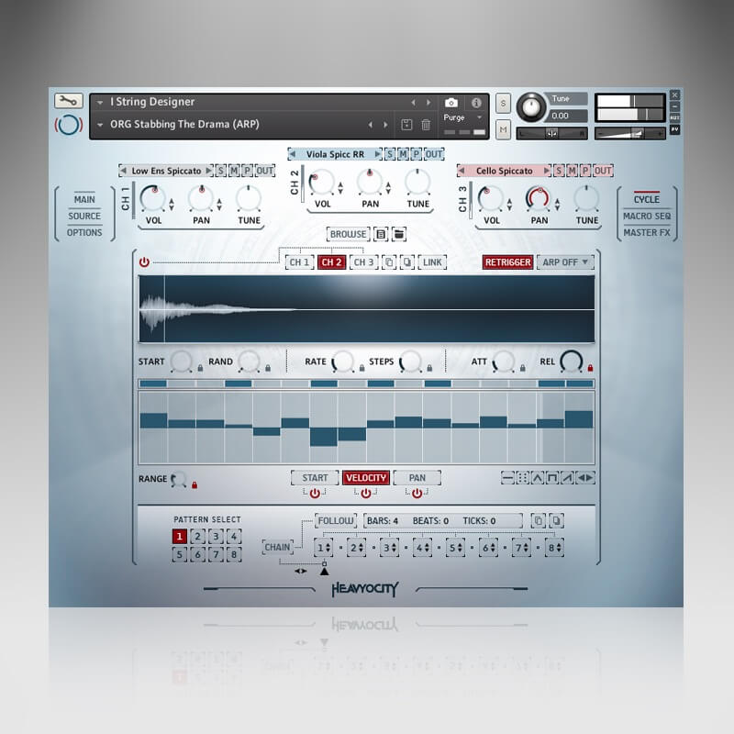
Future Scope
Change accents
Real time document file translation speech
Any type of document extension file can be converted in any type audio extension file.

Slide 10
THANK YOU!

Slide 11
REFERENCES
https://stackoverflow.com/questions/file-dialog-in-tkinter
https://gtts.readthedocs.io/en/latest/
https://www.pygame.org/docs/
https://www.geeksforgeeks.org/python-gui-tkinter/

